Slide 1
Bilingual/ESOL Department
Touch Base Tuesday
Tuesday, March 5, 2019
10:00 a.m. or 3:00 p.m.
Notes:
WELCOME
INTRODUCTIONS

Slide 2

Agenda
Compliance
  Reminders
  Retention of ELLs
  Policy 6000.1
ACCESS for ELLs
Accommodations
ELLevation:
  Change in grading feature
Congratulations
Q & A
Notes:
Posted here are some of the NEW highlights and topics we will be discussing today

Slide 3
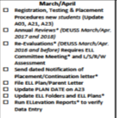
At a Glance

Slide 4
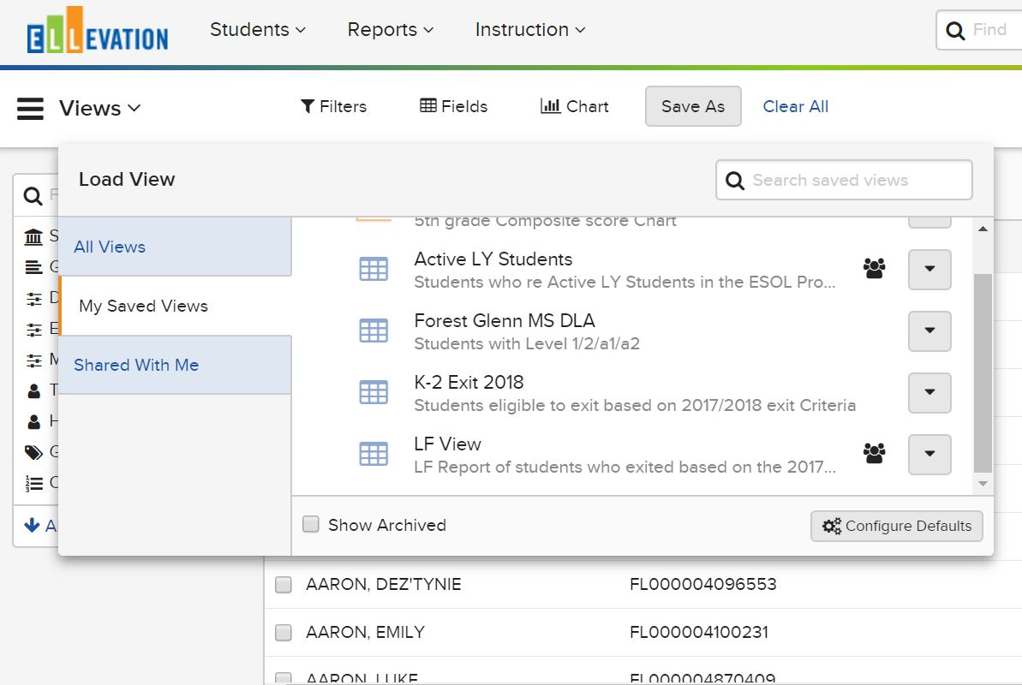
Saved Student Views
Notes:
Discuss the change in verbiage from “Templates” to “Views”
“Views” will house all of the views for student lists (e.g. Active LY Students, LF View)
“Shared with Me” replaces the District Templates (e.g. Active LY Students)

Slide 5
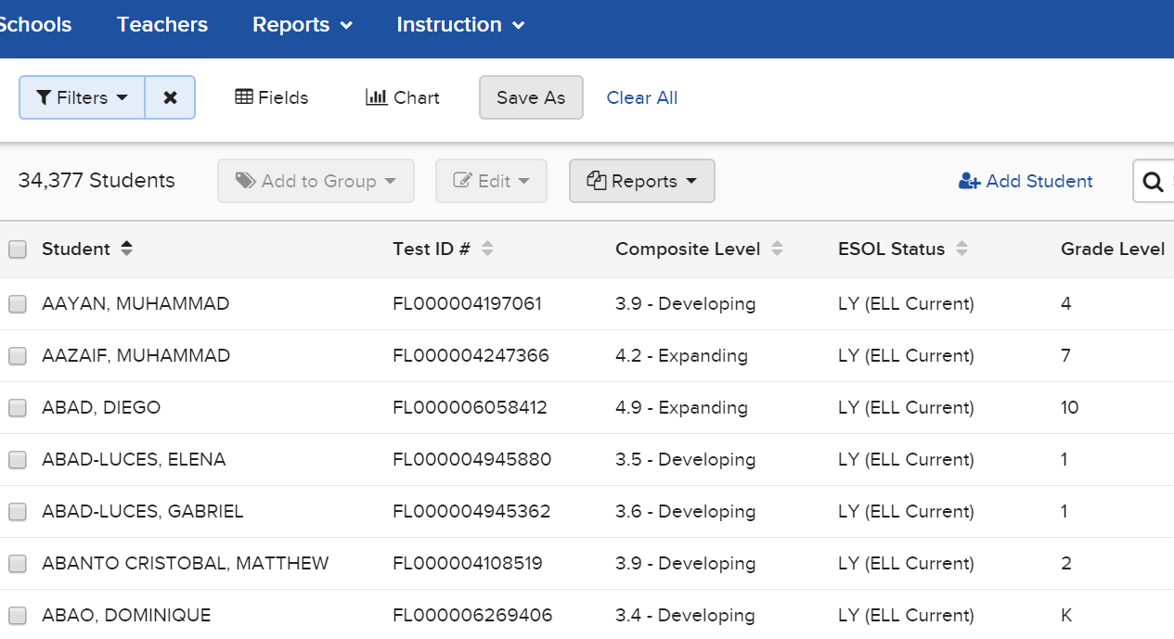
Student View
Notes:
Mention New Student List/Views (10 min) video will be available on SharePoint

Slide 6
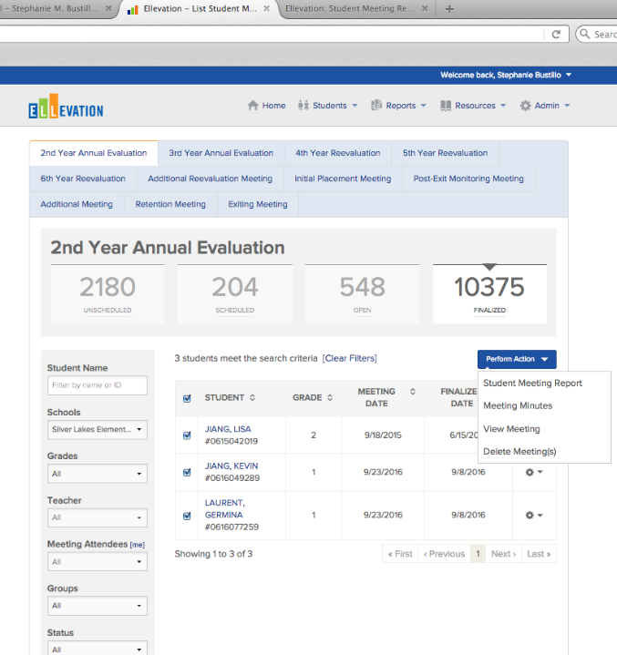
Meetings and Decisions
Remember to generate and sign the Student Meeting Report at time of meeting.
After 48 Hours: Print Parent Notification Letter and save and print the ELL Plan
Notes:
After you or the participants have read the scenario intro the steps/features from this module.
At time of Meeting
Student Meeting Report
After 48 Hours
Parent Notification Letter
Student ELL Plan

Slide 7
Functions of the ELL Committee
Effective July 1, 2018
Function
Resolve any issues affecting instructional decisions of an ELL
May make program placement recommendations
Meeting must be performed on ELLevation
Members
Minimum of 3 School Personnel
Administrator or designee
ESOL teacher
Home language teacher (if applicable)
Classroom/subject area teacher(s)
School counselors, school social workers, school psychologists
Other educators as appropriate
Parents must always be invited to attend
(Dated Parent Invitation letter)
*Signatures in blue or black ink are required for all participants including administrators. Parent(s) and/or guardians are always invited, however, if they do not attend, the meeting still take place. The outcome of the meeting is made available to parents in writing via the Parent Notification Letter in their native language and filed in the ELL Folder.
Section 8 of ESOL Handbook
Notes:
The purpose of an ELL Committee is to resolve any issues that impact the instruction of an ELL student. The committee is able to make decisions of program placement and extension of services. The meetings must be document on ELLevation by the ESOL Contact or designee at the time of the meeting. An ELL Committee consists of at leas 4 school personnel, which can include and administrator, teacher, school counselor, social work, psychologist, or any other educator involved in the instruction of an ELL. Parents must be invited to attend the meeting. Invitation Letters are available in English, Haitian-Creole, Spanish, and Portguese on the Bilingual/ESOL website.

Slide 8
What’s the difference?
Annual Reviews
REEVALS (Extension of Services)
Recommendations for continued placement for ELLs entering years 2 and 3
ELLevation: Me, Myself & I Meeting
TERMS: PLAN DATE
Recommendations for ELLs entering years 4, 5, 6 and beyond
IPT assessment (L/S/R/W) must be administered
ELL Committee IS required and must substantiate 2 out of 5 state approved rationale
TERMS: Update PLAN and REEVAL dates (date of ELL Committee Meeting)
Notes:
Save ELL Plans….
For Students Entering Years 2 and 3: Annual Review
The ESOL Contact must make recommendations for continued placement in the ESOL Program within 30 days prior to the anniversary date (e.g., Date of Entry in a United States School, if DEUSS is not available use the Date of Entry in the ESOL program) for every ELL receiving services in the program.
For a recommendation for years 2 and 3, the Annual Review must be documented on ELLevation and an ELL Plan is printed for the ELL Folder.
The Information Management Technician/Specialist (IMT/IMS) must also update the plan date on the A23 Panel.
An ELL Committee meeting is not required for this recommendation
Reclassification
An English Language Learner (ELL) Committee must be convened to reclassify a former ELL (LF) as an LY. Districts must not change any of the original information because the only way for a student to be reclassified or re-exited is through an ELL Committee. The district would report the ELL: Reclassification Date. When a reclassified ELL exits the ESOL program again, the district would report the ELL: Reclassification Exit Date.
REEVALS:
An ELL Committee must make recommendations for extension of services on the ESOL Program within 30 days prior to the anniversary date (e.g., Date of Entry in a United States School, if DEUSS is not available use the Date of Entry in the ESOL program) for every ELL who has completed a 3-year base period.
Any student being considered for extension of services shall be assessed with IPT (L, S, R, and W) no earlier than 30 days prior to the student’s anniversary date. However, if the anniversary date is before October 1st, the student’s CELLA (2015) and FSA scores can be used in lieu of IPT.
The ELL Committee must convene to review the student’s plan and make a final recommendation.
Once the committee has finalized recommendations and signatures have been obtained, place a the original in the ELL Folder.
Extension of Instruction
Extension of Instruction also requires an ELL Committee to extend services beyond the base three years of in- struction (based on three years from the Date Entered a US School [DEUSS]) and must convene annually for the 4th, 5th, and 6th year. Again, do not change any of the original information because the only way to extend services is through an ELL Committee. After the 6th year, the district is required to continue providing services; however, the Florida Education Finance Program (FEFP) code of 130 must be changed to Basic. After the base period of three years, the District would report ELL: Reevaluation Date.
The ELL: Post Reclassification Dates would be reported to document the required two-year monitoring period once an LY is determined to be an LF.
Let’s identify how to calculate Years in ESOL….Reminder Year Calculations … calculate school years not calendar years…
Ex. Juan’s DEUSS date is 2/24/14. He is in year 3 of the ESOL Program
Year 1: 13/14
Year 2: 14/15
Year 3: 15/16

Slide 9

Question: How can we estimate ELL FTE Projections for 2019 -2020?
Although FTE Projections are NOT our area of expertise, consider the following:
Number of students exited for the 2018-2019 school year- automated sweep
Pattern on NEW ELL enrollment at your location
Long-term ELLs with more than 12 FTE periods(6 years) will not receive FTE funding
ESE/ELL students will receive ESE funding over ELL FTE funding
Notes:
Although FTE Projections are NOT our area of expertise, consider the following:
Number of students exited for the 2018-2019 school year- automated sweep
Pattern on NEW ELL enrollment at your location
Long-term ELLs with 12 FTE periods(6 years) will not receive FTE funding
ESE/ELL students will receive ESE funding over ELL FTE funding

Slide 10

Saved Student Views
Notes:
There are District Views which you can see on the shared with me tab.
This includes:
Active LY Students View
LF Students View – Active
LF Students View- Inactive( Students who have withdrawn from the District)
Immigrant Students View

Slide 11

Scenario
Notes:
Registration Form
Tier Reports
Immigrant Report
WIDA ISR

Slide 12
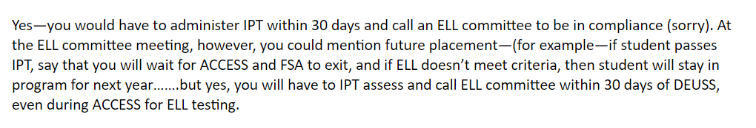
REEVAL Meeting
Q: How do you handle students who are due for Extension of Services in the middle of ACCESS testing?
Do we administer our IPT L/S/R/W in order to have an ELL Committee within the 30 days?
Remember to generate and sign the Student Meeting Report at time of meeting.
After 48 Hours: Print Parent Notification Letter and save and print the ELL Plan
Notes:
After you or the participants have read the scenario intro the steps/features from this module.
At time of Meeting
Student Meeting Report
After 48 Hours
Parent Notification Letter
Student ELL Plan

Slide 13

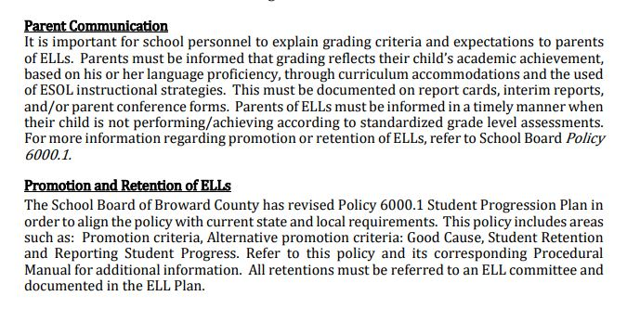
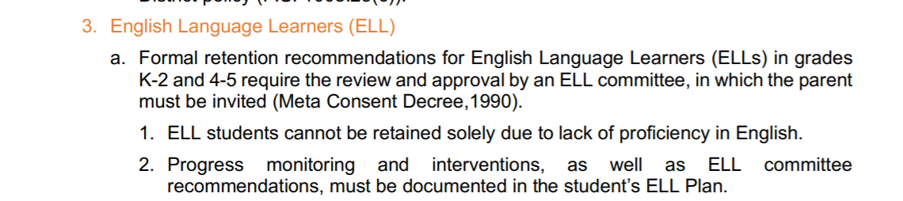
Source: Policy 6000.1
Notes:
Policy 6000.1 as of 08/2017

Slide 14

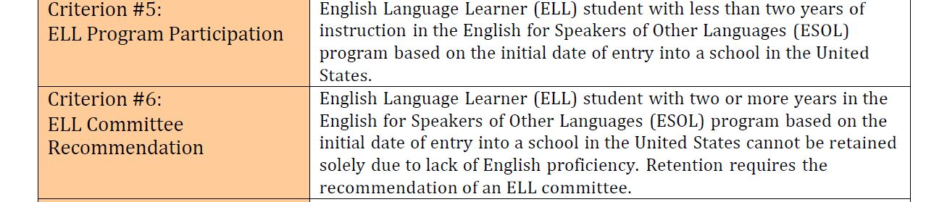
Notes:
Policy 6000.1 as of 08/2017

Slide 15
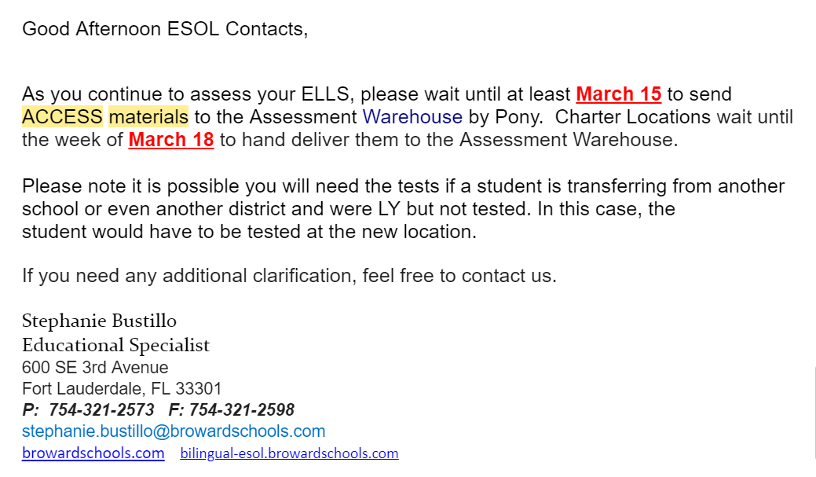
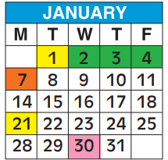
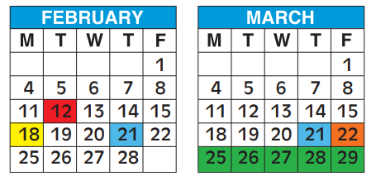
2018-2019 ACCESS for ELLs
Login: florida
Password: sunshine
2018- 2019 Testing Window:
1/28/19 – 3/21/19
(8 weeks)
https://wida.wisc.edu/
Notes:
Please take a look at the suggested timeline for Return, an email was sent to all ESOL Contact on:
ACCESS for ELLs
Assessors are required to become certified in Assessment Areas
Can already become assessors on wida.us
Login: Florida
Password: Sunshine
Find out how many assessors they are certified at their location
Testing Calendar: 1/28/19 – 3/21/19
Materials will be delivered on 1/22/2019
Charter locations can pick-up after 1/22/2019

Slide 16
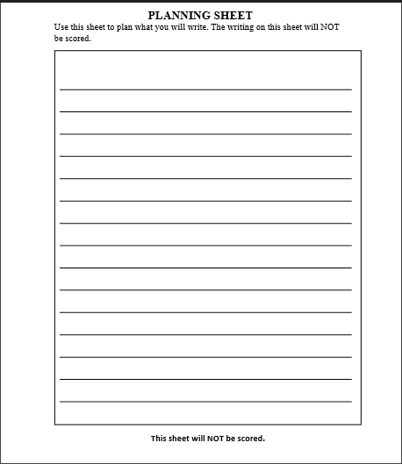

2018 - 2019 Planning Writing Sheet for ACCESS for ELLs
file:///C:/Users/p00053710/Desktop/WIDA_Writing_Planning%20Sheet.pdf
Notes:
Writing
A Student Planning Sheet can initially be provided to students at the beginning of the domain. As needed, additional sheets can be provided to students during the test. All USED planning sheets must be returned with test materials(is considered secure materials). (will be added to manual next year)

Slide 17

Student Transfers during ACCESS
Student Transfers
  Student transfer guidance can be located in the below sections of the Spring 2019 FL ACCESS for ELLs Test Administration Manual.
    Section 6.3 provides guidelines on how to handle students who transfer prior to or during the testing window.
    Section 7.2 provides guidance regarding common errors and unique situations.
Contact Student Assessment if you have additional questions.
(754) 321-2500
Notes:
ACCESS for ELLs
Student Transfers
Student transfer guidance can be located in the below sections of the Spring 2019 FL ACCESS for ELLs Test Administration Manual. Note: If the situation is not addressed in either section, please contact Sabrina Read via email at sabrina.read@fldoe.org to discuss next steps.
Section 6.3 provides guidelines on how to handle students who transfer prior to or during the testing window.
Section 7.2 provides guidance regarding common errors and unique situations.
The Student Transfer Form should be completed when a student transfers outside the district, but within the state, during testing and has completed one or more domains.
The form should not be submitted if the student completed all four domains prior to transferring.
Prior to submitting the Student Transfer Form, the receiving district should consult with the sending district regarding status of ACCESS for ELLs testing.
WIDA AMS Pathway: All Applications > Student Management > Student Transfer Form
Key Resource: WIDA AMS User Guide Pages 90–92
If the student has remaining domains to complete, the receiving school may proceed to test student after affixing a District/School Label to a new test booklet and gridding the following fields:
Student’s Name*,
Date Testing Ended,
District Code,
School Code,
State Student ID (FLEID)*,
Date of Birth*,
Grade*,
Accommodations (if applicable)
*Information submitted in WIDA AMS must match the test booklets in order to generate a complete score report.

Slide 18
Testing Accommodations
ELLs (LY) are provided accommodations in the administration of statewide assessments AND daily instruction
Be sure to assign Accommodations BEFORE printing ELL Plan
Flexible Scheduling/Additional Time
Assistance in Heritage Language
Flexible Setting
Bilingual Dictionary/Glossary
*NOTE: LFs do not receive accommodations
Notes:
Flexible Setting requires a letter home
ACCOMMODATIONS ARE ASSIGNED ONCE A YEAR
We assign accommodations for the entire school year
Revisit each year for LY

Slide 19
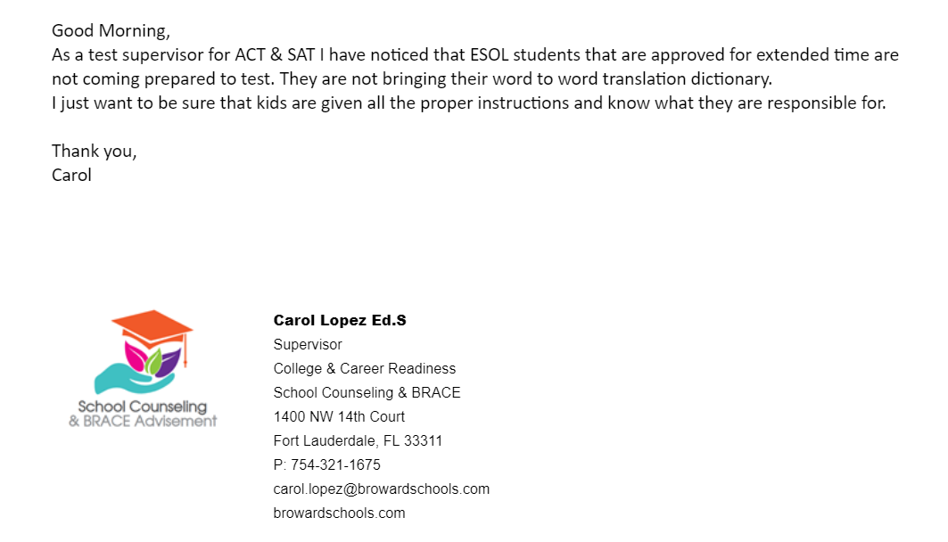



Accommodations and Instructional Practices for English Language Learners (ELLs) for Assessment
Use of a bilingual glossary in addition to a bilingual dictionary.
An approved glossary is defined as word-to-word and may include content specific glossary.
https://collegereadiness.collegeboard.org/sat/k12-educators/sat-school-day/contracts
Rule 6A-6.09091

Slide 20
Accommodations and Instructional Practices for English Language Learners (ELLs) during SAT/ACT
Use of a bilingual glossary in addition to a bilingual dictionary.
An approved glossary is defined as word-to-word and may include content specific glossary.
Evidence of
Bilingual Dictionary
Extended Time
Flexible Setting
Bilingual Support for Lowest-Level ELLs
ELL Engagement in Lesson
ELL Consideration in Lesson Plans
English Language Development Standards in Lesson Plans
Teacher Awareness of ELL Levels of Students
Rule 6A-6.09091

Slide 21
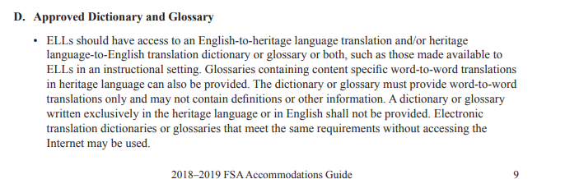
Accommodations
ELLs receive accommodations during
statewide assessments AND daily instruction
An approved glossary is defined as word-to-word and may include content specific vocabulary
Flexible Scheduling/
Additional Time
Assistance in Heritage Language
Flexible Setting
Bilingual Dictionary/
Glossary
Free Printable Content Glossaries:
https://steinhardt.nyu.edu/metrocenter/resources/glossaries
Notes:
Good Morning,
As a test supervisor for ACT & SAT I have noticed that ESOL students that are approved for extended time are not coming prepared to test. They are not bringing their word to word translation dictionary.
I just want to be sure that kids are given all the proper instructions and know what they are responsible for.
Flexible Setting requires a letter home
ACCOMMODATIONS ARE ASSIGNED ONCE A YEAR
We assign accommodations for the entire school year
Revisit each year for LY
Flexible Timing (Additional Time): ELLs may be provided additional time; however a session MUST be completed within one school day.
Limited Assistance in Heritage Language
Approved Dictionary: ELLs MUST have access to an English to heritage language dictionary and/or heritage language to English dictionary (word-to-word).
Flexible Setting: ELLs may be tested in a different room with other ELL students. Parents MUST be informed of this option.
Flexible Scheduling: ELLs may take a session of the test during several brief periods within one school day; however a session of the test MUST be completed within one school day.

Slide 22
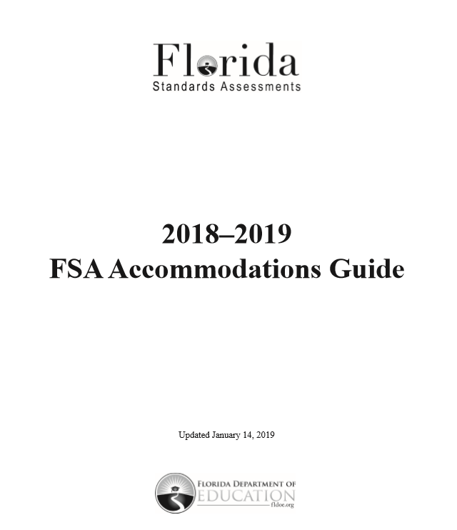
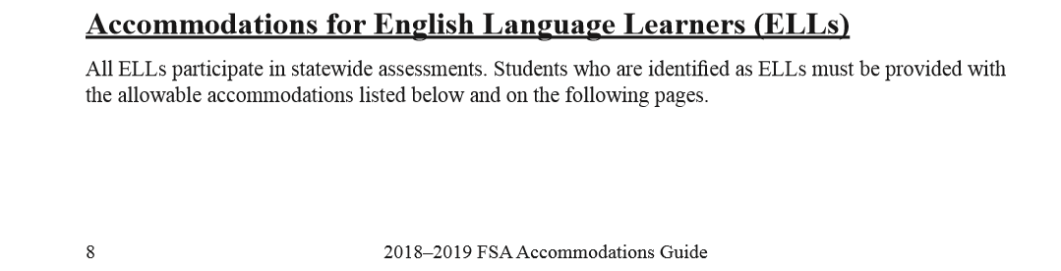
2018-2019 FSA Accommodations
Notes:
Also, consider including a reference to the FAQ for FSA. We are starting to receive questions about that. See attached, beginning on page 8.
We do need to include the disclaimer that in Broward County, ALL ELLs take FSA and other state assessments.

Slide 23
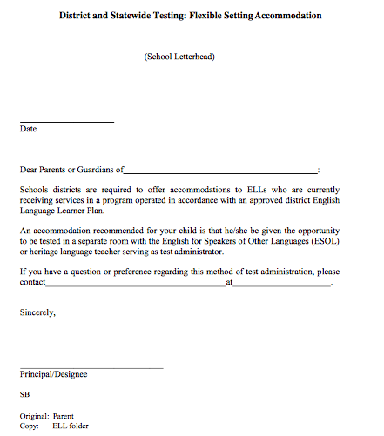
Flexible Setting Letter
Found on Canvas or SharePoint: https://browardschools.instructure.com/courses/598658
https://browardcountyschools.sharepoint.com/sites/Intranet/Academics/learning/ELL/Pages/default.aspx
Section 5 of ESOL Handbook
Notes:
Mel
This is utilized for updating ELL/SEP folder of testing conditions specific to ELLs
These forms will only be utilized if and when the student is removed from the classroom for testing . Both forms then must be filed and sent home to the parents.

Slide 24
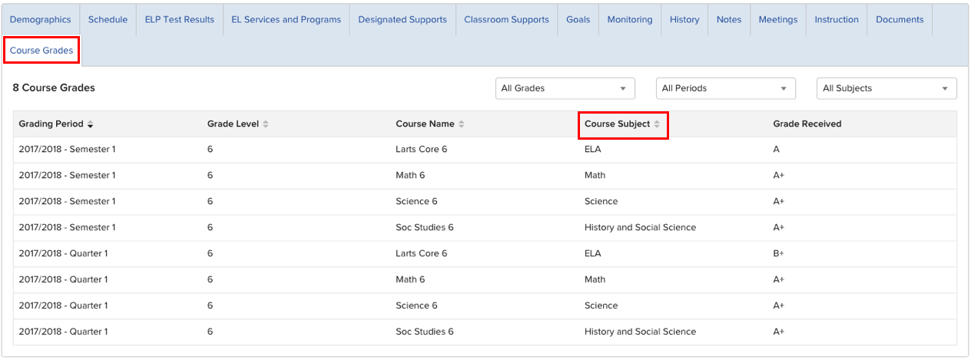
Ellevation Grades Update
Enable English Learning
in ALL Classrooms

Slide 25

Standards Review input requested
Per Gov. DeSantis Executive Order 19-32, the DOE is in process of reviewing the current ELA and Math standards and would like your input
http://www.fldoe.org/standardsreview/
Notes:
Standards Review – input requested
Per Gov. DeSantis executive order, Executive Order 19-32, the DOE is in process of reviewing the current ELA and Math standards and would like your input. Please visit http://www.fldoe.org/standardsreview/ for additional information and a chance to comment on such important educational issues.
Although the ELD standards are not included in this review, ELLs, like all students, will be impacted, so we are requesting that you, your staff and especially your teachers are aware of the review and have the opportunity to share their expertise.
Please feel free to forward this information to all stakeholders, including parents and community leaders.
We look forward to receiving your feedback.

Slide 26

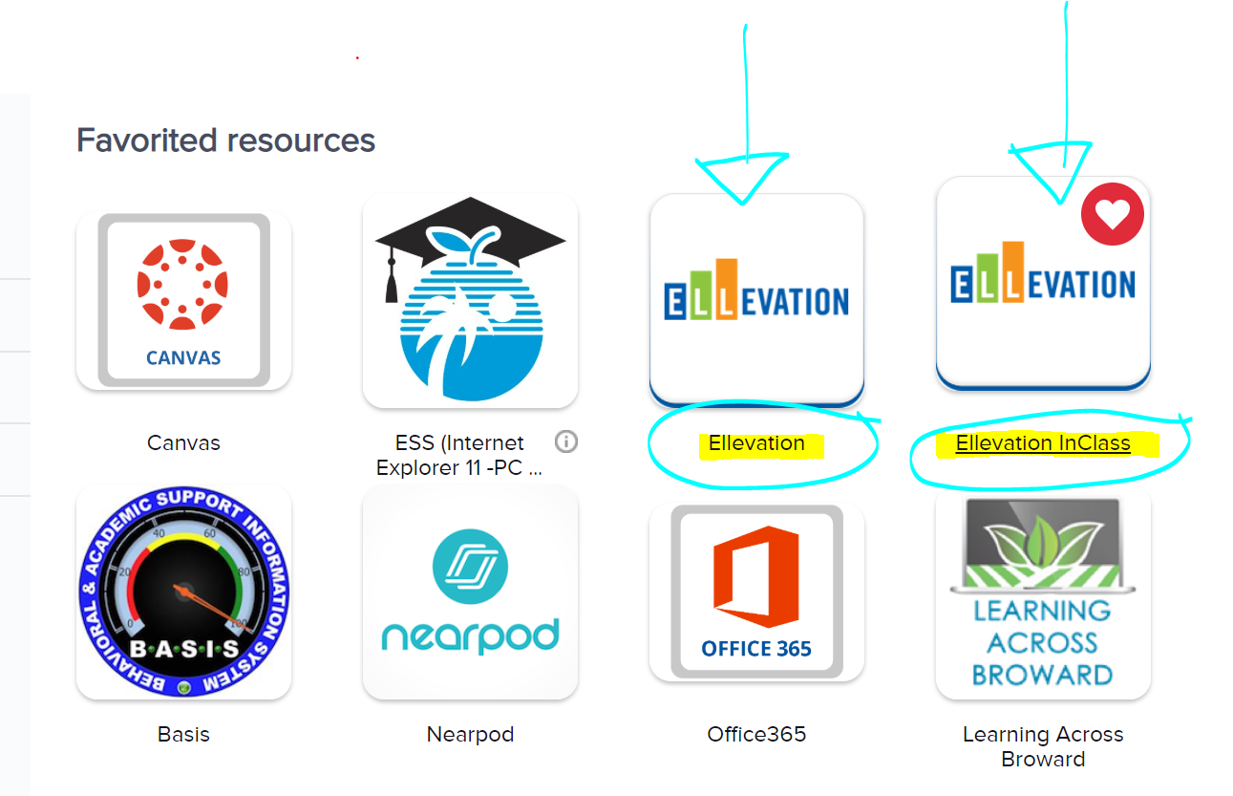

ELLevation- Clever
Notes:
Posted here are some of the NEW highlights and topics we will be discussing today

Slide 27
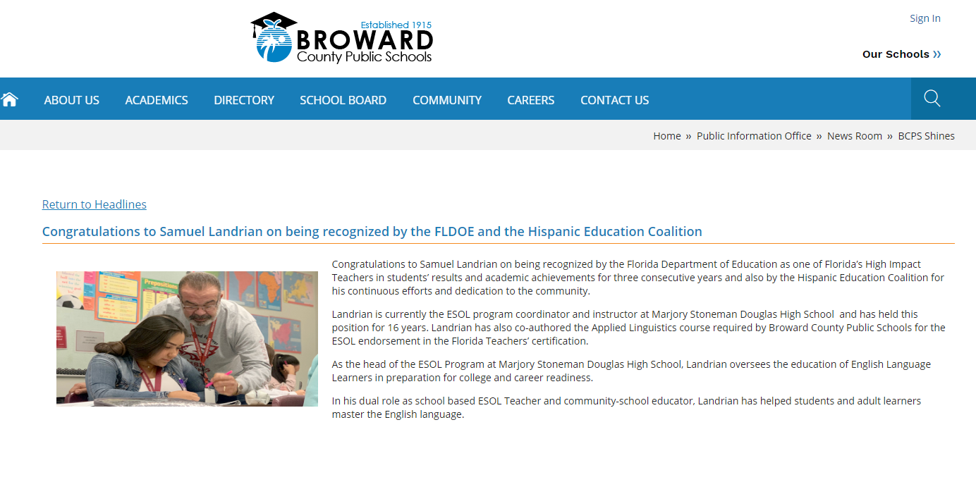
Congratulations! Mr. Sam Landrian
Notes:
FL Dept of Education High Impact Teachers

Slide 28

Will you join us and take the pledge?
bit.ly/ellpledge

Slide 29

2019 ESOL ACADEMIC COMPETITION
(Middle & High School ELLs)
Theme: Navigating the Path to Biliteracy
When: Saturday, April 27, 2019
Where: PIPER High School

Slide 30

ESOL Parent Leadership Council
2018-2019
CHAIR
Maria Gabriela Salas
VICE-CHAIR
Elizabeth Laverde
SECRETARY
Dinorah Rodriguez
Meeting
Thursday, March 14, 2019
6:30p.m. to 8:30 p.m.
Indian Ridge Middle School
1355 S Nob Hill Rd
Davie, FL 33324
Notes:
Programs offered by the District:
Demographics & Student Assignment
Innovative Programs (Magnet)
Dual Language
Exceptional Student Learning Support
HEART (Homeless Education Assistance Resource Team)
Migrant Education Program
School Counseling & BRACE

Slide 31
Parent Outreach Centers
Park Ridge ES – Open Mondays
Tamarac ES – Open Mondays
Oriole ES – Open Thursdays
Outreach Office – Daily 8:00 a.m. to 4:00 p.m.
For more information call the Parent Outreach Office at
754-321-2951

Slide 32



@BrowardESOL
Broward Bilingual ESOL Department
Broward ESOL
Follow Us On Social Media
Notes:
Approx Time: 2 minutes
Presenters’ Notes:
Share social media information. You can follow us on Twitter, Facebook and Pinterest. We tweet, post and pin great resources such as articles, strategies and pictures. We’d love to hear about any of the amazing things that are happening with the ELLs at your school. If you’re hosting an ESOL Family Night, working on a special project or using amazing technology please share!
Materials:
N/A

Slide 33



Slide 34


Slide 35

Vicky B. Saldala, Director
Leyda Sotolongo, ESOL Curriculum Supervisor
Stephanie Bustillo, Educational Specialist
Melinda Mayers, Educational Specialist
Monica Nelsas, Parent Outreach Specialist
Blanca Guerra, World Language Curriculum Supervisor
Idalina Orta, Dual Language Specialist
Reina Murray , Bilingual Guidance Counselor
Celina Chavez, Educational Specialist, Charter School Support
754-321-2590 KCW
754-321-2950 Pembroke Pines
http://esol.browardschools.com
Notes:
Approx Time:
Presenters’ Notes:
Materials:
Presenters’ Resources:

