Slide 1
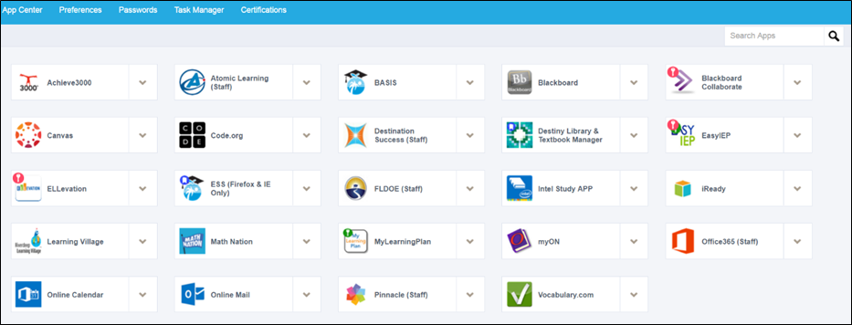
Broward Single Sign-On (SSO) Launchpad
After signing into the new Broward Single Sign-On Launchpad, you’ll have access to many of your applications with a single sign-in.
NOTE: Most apps will only be accessible on the Launchpad. So you need to download the Launchpad registration.

Slide 2
Broward Single Sign-On (SSO)
One-Stop Access - many of the applications you use on a daily basis will be available in one location.
Self-Service Password Updates - No more calling the Service Desk to update your password.
Easier Access from Home - The Broward SSO Launchpad link will be accessible from home.
http://sso.browardschools.com/

Slide 3
Broward Single Sign-On (SSO) Registration Steps
The one-time registration process takes 7 short steps.
The one-time registration process takes about 5 minutes to complete.
1. Navigate to the Broward Single Sign-On (SSO) page.
2. Click the button that says "Register Now / Login".
3. Enter your username and password on the Sign In page. Enter Outlook/E-mail User name & Password.
4. IF IT IS THE FIRST TIME, set up your security questions. Follow prompts.
5. IF PROMPTED, install the Browser Plugin. Follow prompts.
6. The Launchpad should be visible.
7. IF IT IS THE FIRST TIME, please logout & close the browser to complete your account set-up.
http://sso.browardschools.com

