Slide 1
What is a gap year, and how do I take one before college?
Presented by Warren Oliver (FSU CRE Associate Director for Global Programming)

Slide 2
Session Agenda
6:00pm-6:05pm: Introductions
6:05pm-6:20pm: Brainstorm Activity about Gap Years
6:20pm-6:35pm: Define Gap Years and Experiences
6:35pm-6:45pm: Explain Gap Years at FSU
6:45pm-7:00pm: Q&A

Slide 3
Quick Question
What is a Gap Year, and why might it be helpful to take one?
What are your goals for taking a Gap Year?

Slide 4
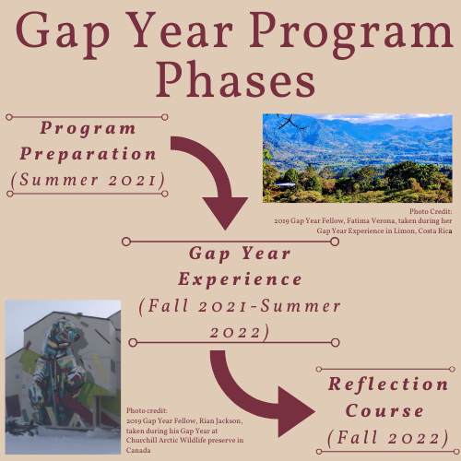
So what is a Gap Year?
Helpful links:
Gap Year Association
Definition and History
Focus: Finding personal Interest to center experiences
3 Phases:
Preparation
Experience
Reflection

Slide 5
Phase 1: Preparation
How should we prepare for such an experience?
Preparation Goals:
Discuss goal setting and planning
Explain the need for flexibility to still meet goals in difficult environments
Plan intended gap year experiences
At FSU: covered as part of Info Sessions (the summer before an experience)

Slide 6
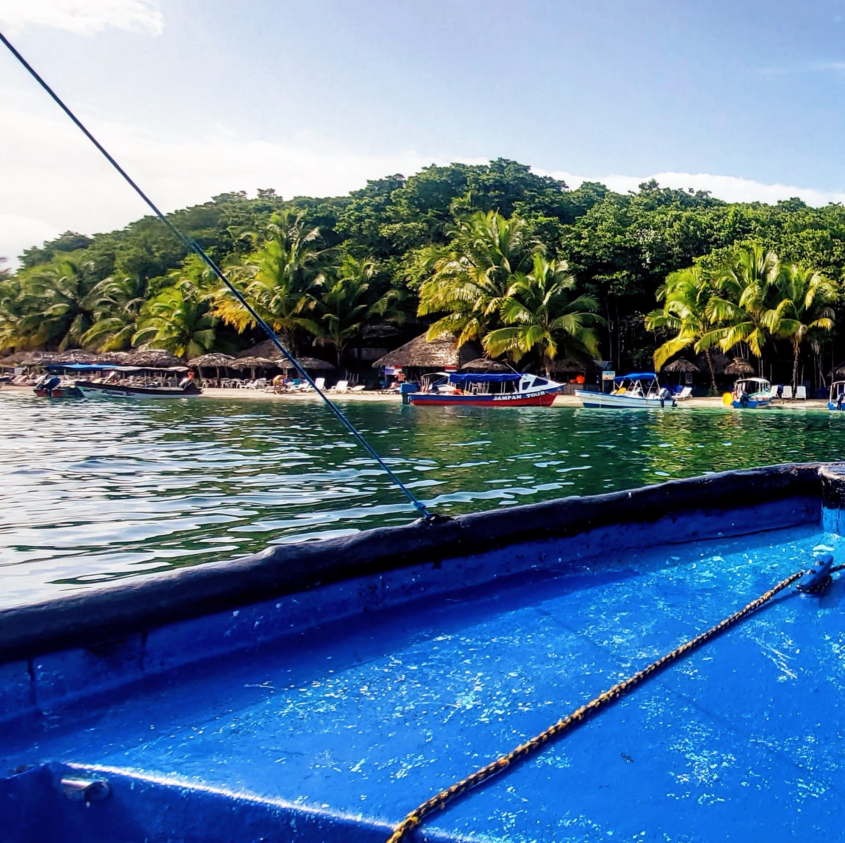
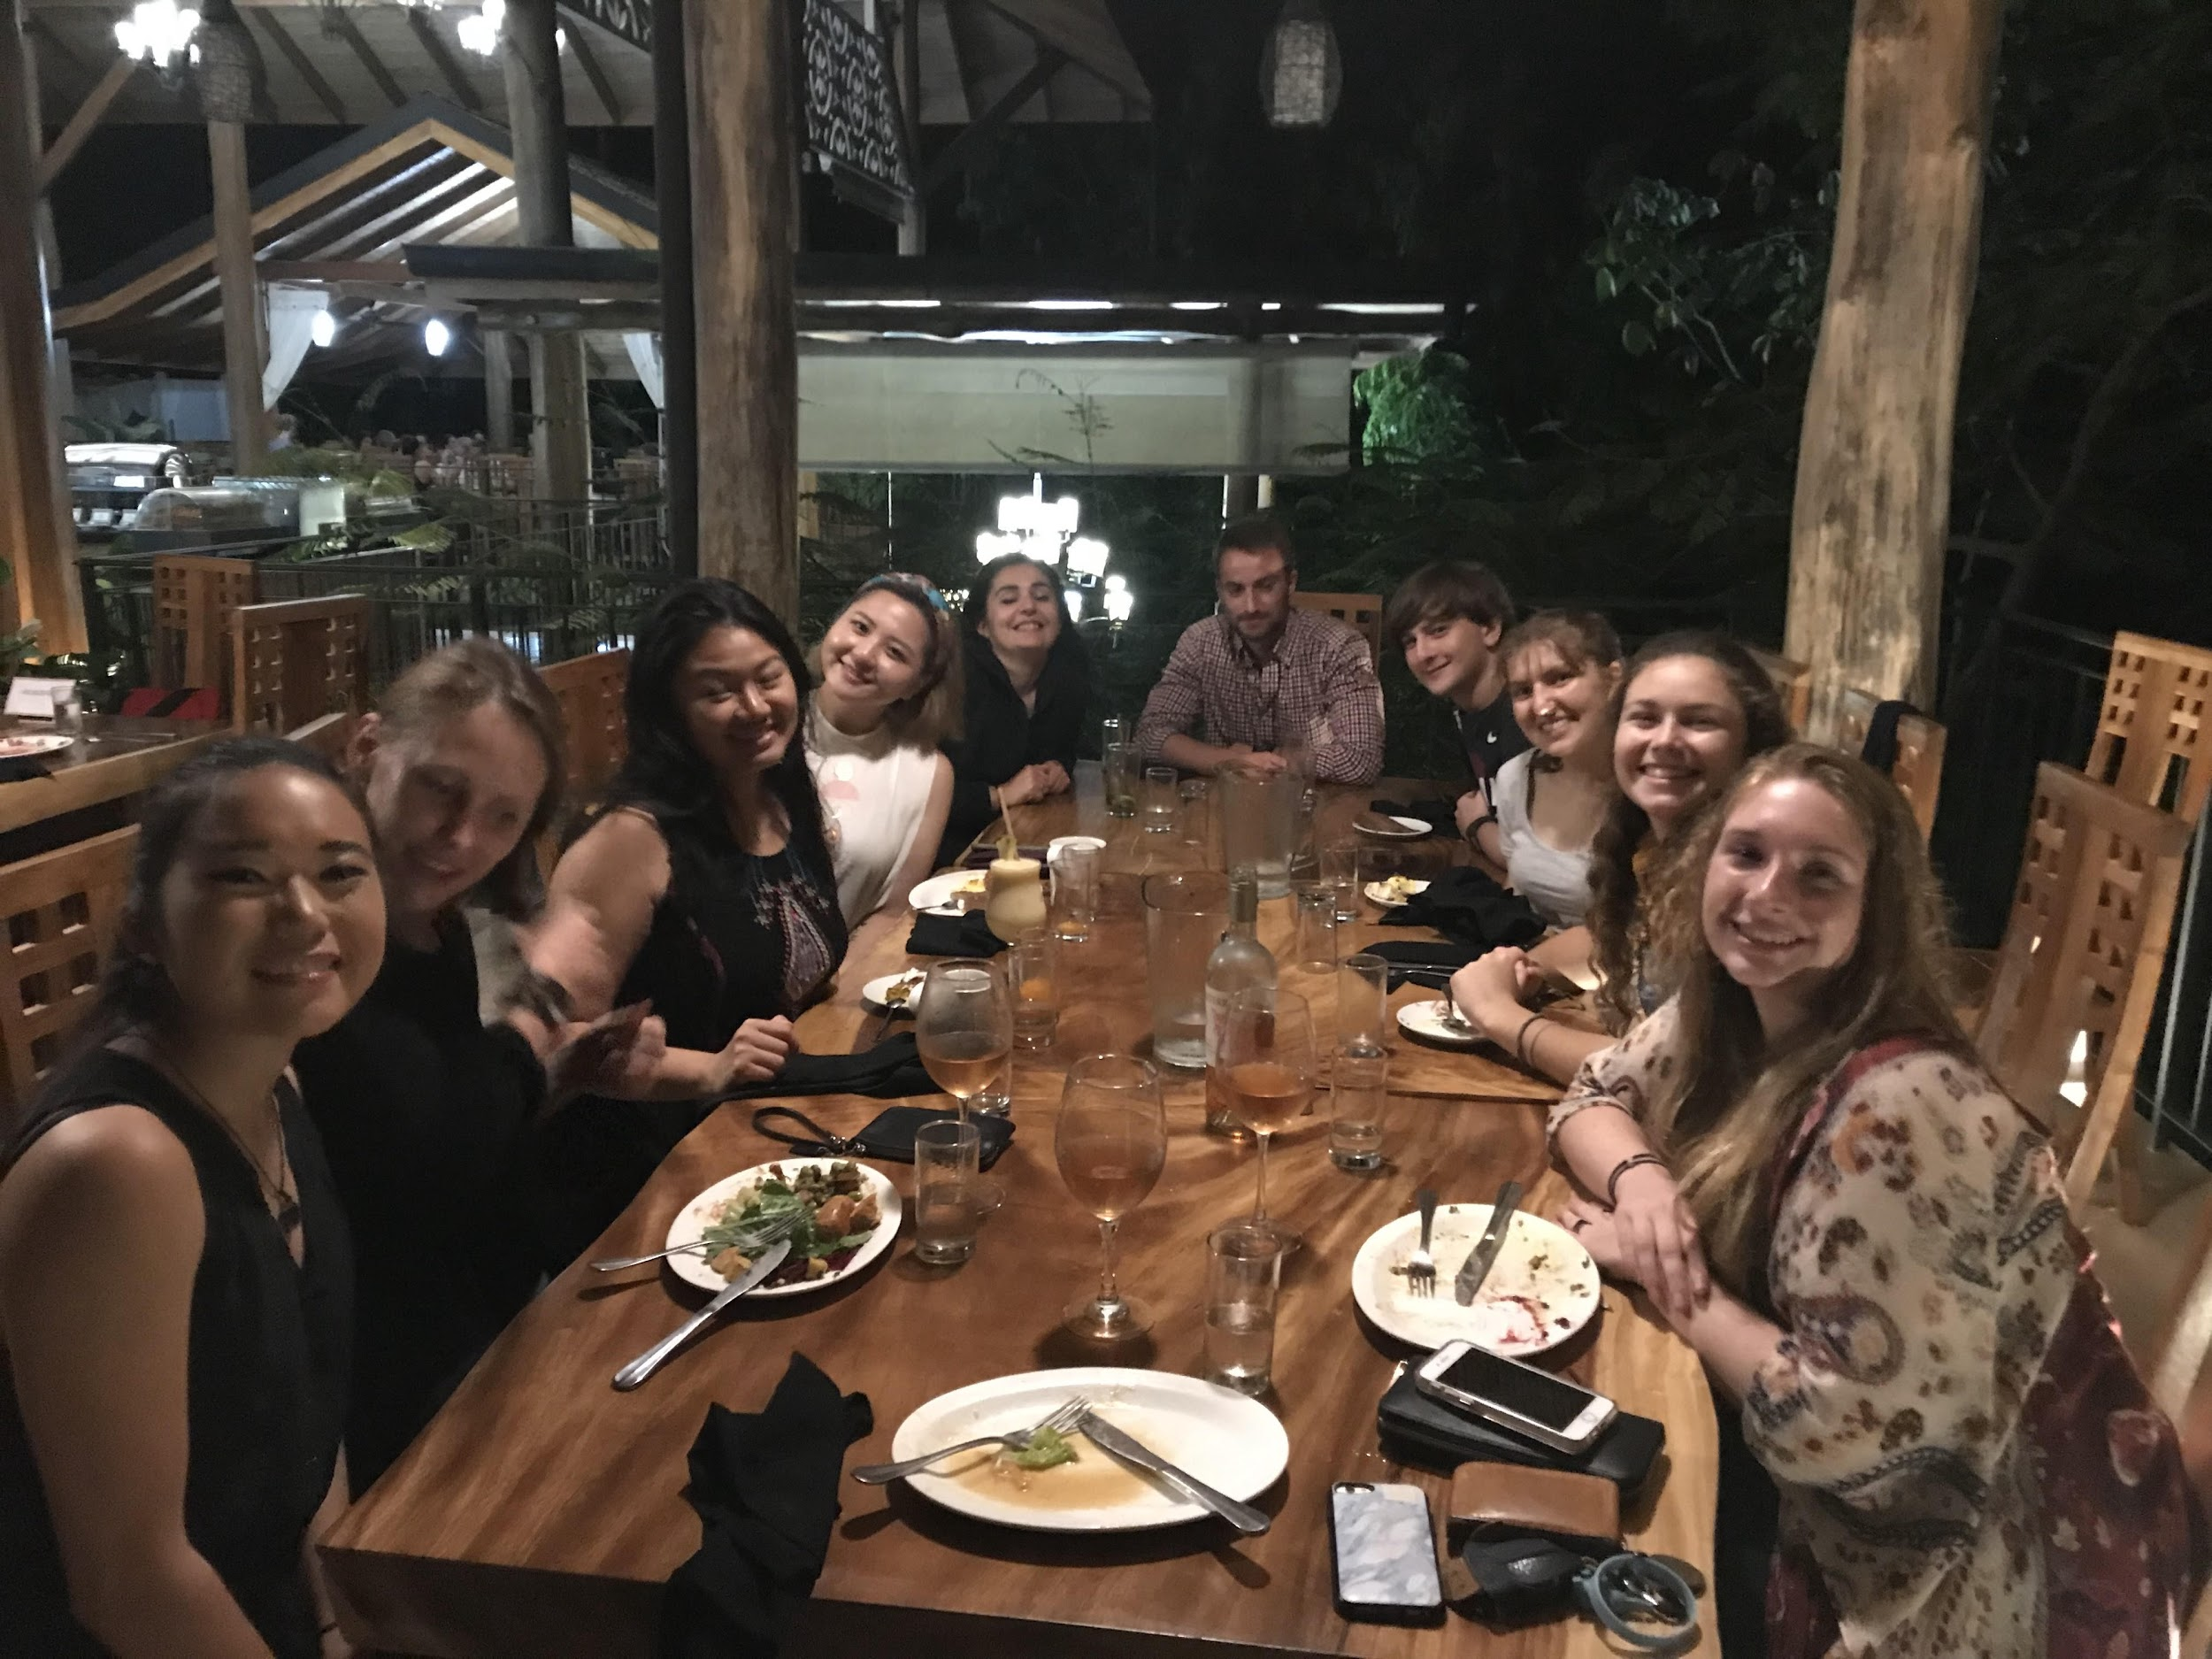
Phase 2: Student Experience
Specifics TBD by student
Goal: have the experience you’ve planned for
Remote, Domestic, and International Opportunities
Student-Developed
Independent Experience developed during summer
Can be tweaked throughout the year

Slide 7
Phase 3: Reflection
Using your experience to make the most of college
Goal: How to follow up on THAT?
Reflect on gap year experiences
Explore forms of engagement (both academic and extra-curricular)
Plan for future undergraduate experience based upon reflections and observations from gap year
At FSU: covered in a Fall Engage-100 course for students (the first fall at FSU)

Slide 8
Developing Your Experience
Part of the Preparation Sessions (don’t worry if you do not know exactly what you want to do now)
Should be relevant to your
Interests
Abilities
At FSU: Part of the Preparation Sessions (the summer before an experience)

Slide 9
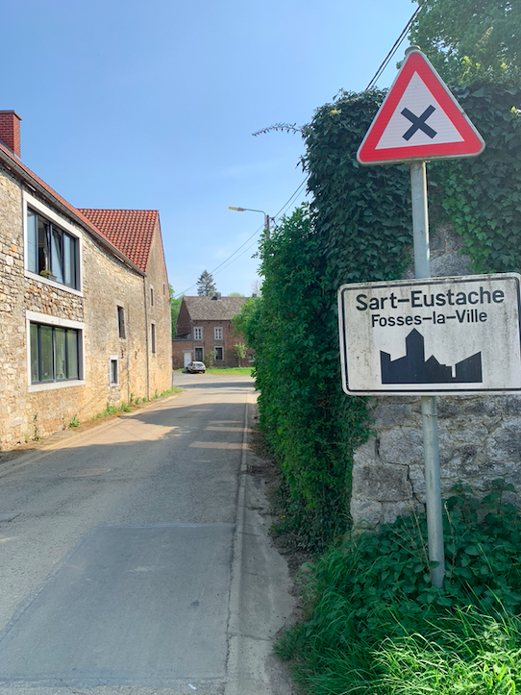
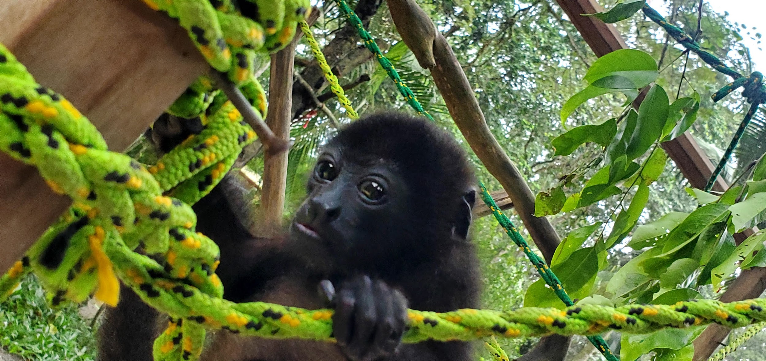
So what are experiences like?
Check out FSU’s Gap Year students’ Experience Blogs to find out more!

Slide 10
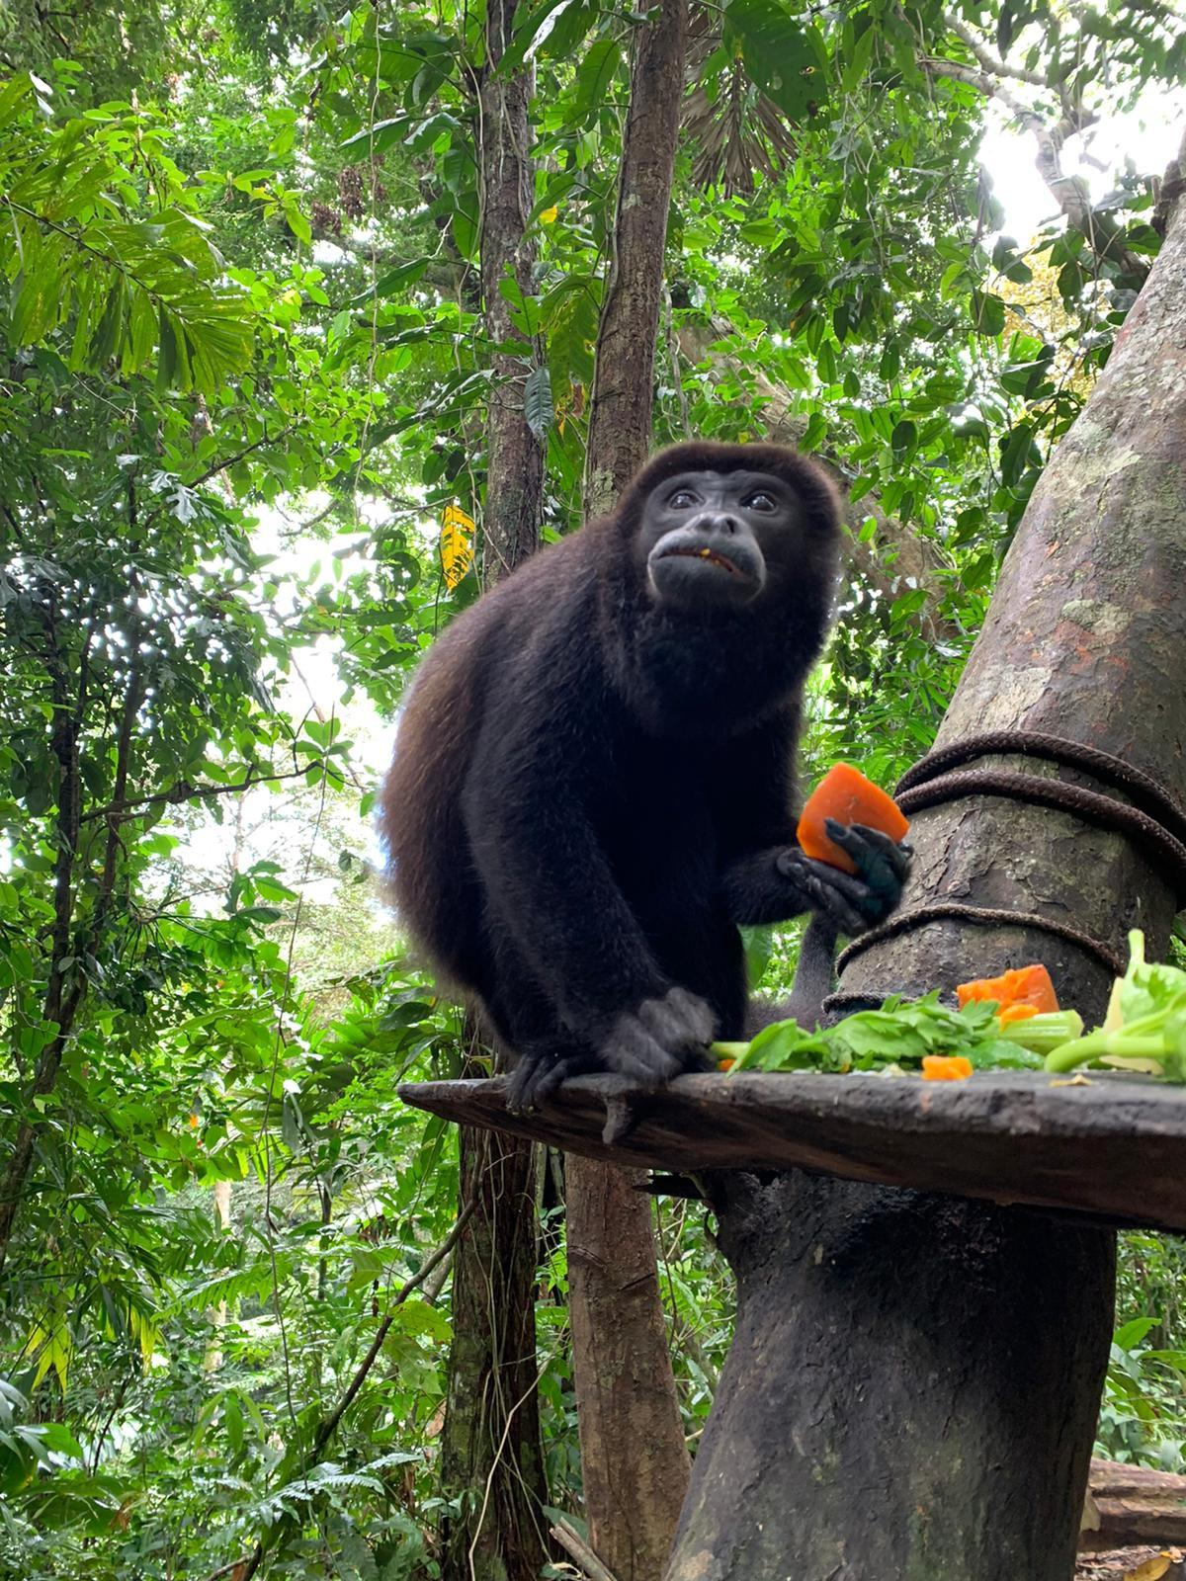
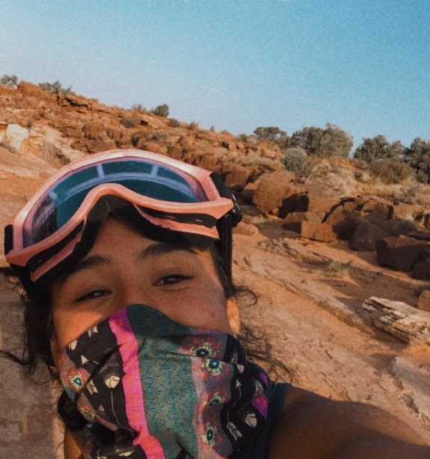
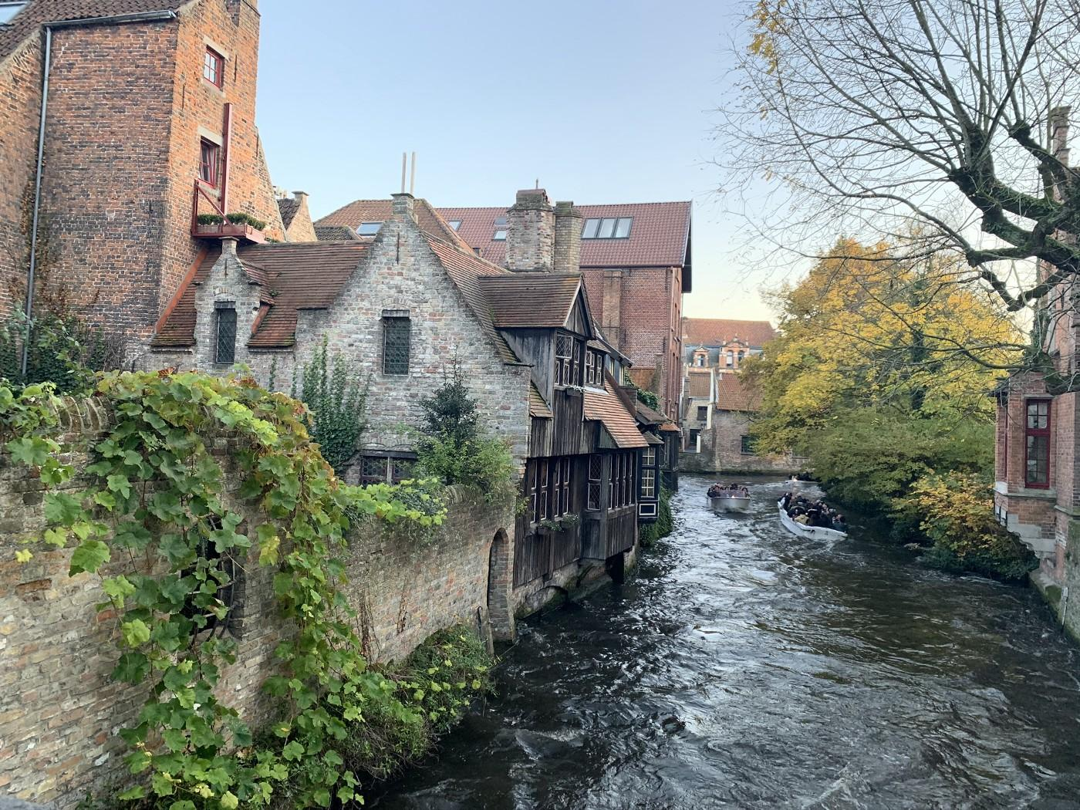
Examples of Experiences
Gap Year Association List
Global Citizens Academy
WWOOF
GoAbroad
GoOverseas
Omprakash
Americorps
Student Conservation Association

Slide 11
FSU’s Gap Year Program
A fairly unique program
Offers students the opportunity to take a gap year before coming to FSU via a 12-month deferment
A 3-part program intended to enable students to design, inact, and reflect upon their gap year experiences
Grounds future undergraduate experience within personal interest
Grants formative experience to students through the Gap Year Engage-100 course

Slide 12
FSU’s Gap Year Fellows Funding
Up to $5000 for expenses related to gap year experience
Only offered to qualifying projects:
Intercultural experience
Service-centered
Must be at least 6 months
Bright Futures Funding would not apply to the Gap Year

Slide 13
Application Process at FSU
Apply to and be accepted by FSU
Apply to FSU’s Gap Year Program
FSU GYP application:
Questions will ask about:
You (fill in the blanks: name, major, etc)
Your interest in the Gap Year and thoughts for the experience
If you want to pursue funding
Letter of recommendation (from someone who can speak about your abilities to do such a program)

Slide 14
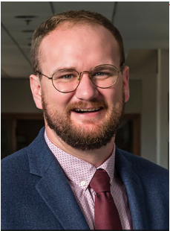
Contact Warren Oliver
Email: boliver@fsu.edu
Phone: (850) 644-7420
Online: https://cre.fsu.edu/global/gapyear

Slide 15
Contact the CRE Office
cre@fsu.edu
@CREFSU
(850) 645-9630
@CRE_FSU
www.cre.fsu.edu
@FSU_CRE

